Slide 1





CAPSTONE PROJECT
KEYLOGGER
Presented By:
Hemalatha.N - GTEC - IT

Slide 2
OUTLINE
Problem Statement
Proposed System/Solution
System Development Approach
Algorithm & Deployment
Result
Conclusion
Future Scope
References

Slide 3
Problem Statement
In the realm of cybersecurity, the emergence of keyloggers poses a formidable threat to the confidentiality and integrity of sensitive information. These malicious tools surreptitiously record keystrokes, enabling cybercriminals to intercept sensitive data such as login credentials, financial information, and personal communications. As keyloggers evolve in sophistication and prevalence, the challenge of detecting and mitigating their impact becomes increasingly urgent. Thus, there is a pressing need to develop effective strategies and technologies to detect, prevent, and neutralize keyloggers, thereby safeguarding individuals and organizations from the pervasive threat of unauthorized data interception and exploitation.

Slide 4
Proposed Solution
The proposed solution aims to tackle the challenge of developing a keylogger that can effectively detect and prevent unauthorized data interception by cybercriminals. This solution will involve the following components:
Keylogger Development
Design and implement a keylogging software capable of discreetly recording keystrokes on the target system.
Ensure the keylogger operates stealthily to avoid detection by users and antivirus programs.
Develop mechanisms to securely store captured keystrokes to prevent unauthorized access by malicious actors.
Detection Mechanisms:
Integrate advanced detection algorithms to identify the presence of keyloggers on targeted devices.
Employ heuristic analysis and anomaly detection techniques to identify suspicious behavior indicative of keylogging activities.
Implement real-time monitoring capabilities to promptly detect and alert users of potential keylogger infections.
Prevention Strategies:
Incorporate preventive measures to mitigate the risk of keylogger infiltration, such as encryption of sensitive data input fields.
Integrate anti-keylogging features into existing security software suites to provide comprehensive protection against keylogging threats.
Educate users on best practices for preventing keylogger attacks, including the importance of regular software updates and the use of virtual keyboards for sensitive input.
Testing and Evaluation:
Conduct rigorous testing to validate the effectiveness and reliability of the keylogger in detecting and preventing keylogging activities.
Evaluate the performance of the keylogger against various attack scenarios and benchmark it against existing solutions.
Solicit feedback from security experts and end-users to refine the keylogger's functionality and usability.

Slide 5
Deployment:
Package the keylogger solution into a user-friendly application or software suite for easy deployment on targeted systems.
Provide comprehensive documentation and support resources to assist users in configuring and utilizing the keylogger effectively.
Ensure compatibility with a wide range of operating systems and software environments to maximize accessibility and usability.
Result:
Upon successful implementation and deployment, the proposed keylogger solution will empower individuals and organizations to proactively defend against the pervasive threat of keylogging attacks. By combining robust detection mechanisms with preventive measures, the solution will enhance cybersecurity resilience and safeguard sensitive information from unauthorized interception and exploitation.

Slide 6
System Approach
The development and implementation of the keylogger system involve a structured approach encompassing various stages, from defining system requirements to deploying the final solution. The following outlines the system approach for this project:
System requirements
Define the functional and non-functional requirements of the keylogger system, including its core functionalities, performance expectations, and security considerations.
Identify the target platforms and operating systems for deployment, ensuring compatibility and accessibility across diverse environments.
Specify the user interface requirements to ensure usability and ease of interaction for both administrators and end-users.
Library required to build the model
tkinter: For developing the graphical user interface (GUI) of the keylogger system.
pynput: For capturing keyboard events and implementing the keylogging functionality.
json: For serializing and deserializing data in JSON format for storing logged keystrokes.

Slide 7
Algorithm
The keylogger algorithm plays a crucial role in capturing and processing keystrokes effectively while ensuring the system's efficiency and reliability. Below is an outline of the keylogger algorithm:
Initialization:
Initialize the keylogger system, including setting up event listeners and data structures to store captured keystrokes.
Keystroke Capture:
Continuously monitor keyboard events using event listeners, capturing each keystroke as it occurs.
Record the timestamp, key type (pressed, held, released), and the corresponding key code or character.
Data Processing:
Preprocess the captured keystrokes to filter out irrelevant or redundant information.
Organize the keystroke data into a structured format for storage and analysis, such as JSON or CSV.
Storage and Logging:
Store the processed keystroke data securely, ensuring encryption and protection against unauthorized access.
Implement logging mechanisms to maintain a record of all keystrokes captured over time, facilitating analysis and forensic investigations.
User Interface Interaction:
Develop user interface components to interact with the keylogger system, including options for starting/stopping logging, viewing logs, and configuring settings.

Slide 8
DEPLOYMENT
The deployment of the keylogger system involves preparing the software for installation and usage in various environments. Here's an overview of the deployment process:
Installation:
Install necessary packages using pip:
C:\Users\name>pip install pynput
Download the keylogger script (keylogger.py) onto the target system.
Configuration:
Modify any configuration options in the keylogger script as needed (e.g., output file path, logging settings).
Execution:
Open a terminal or command prompt.
Navigate to the directory containing the keylogger script.
Run the keylogger script using Python:
C:\Users\name>python keylogger.py

Slide 9
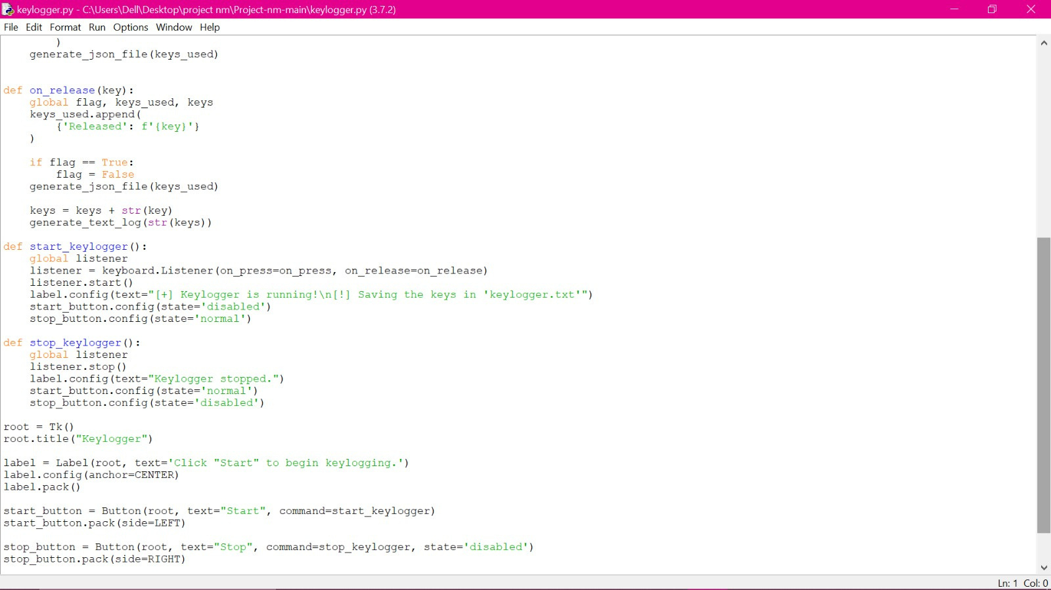

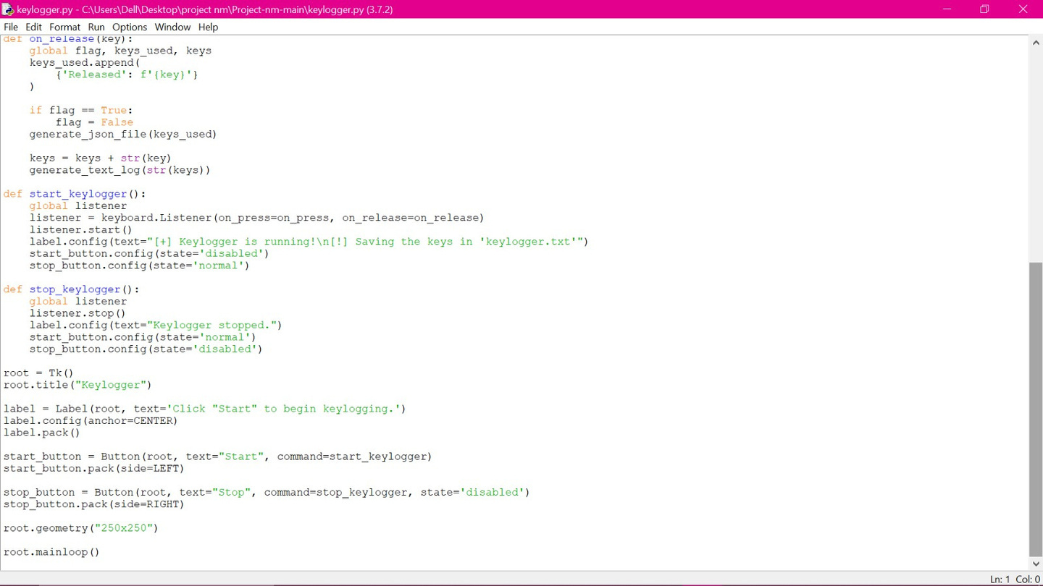
Source code

Slide 10

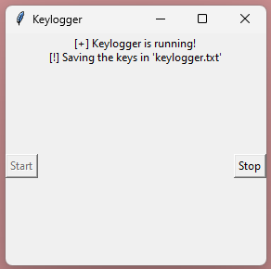
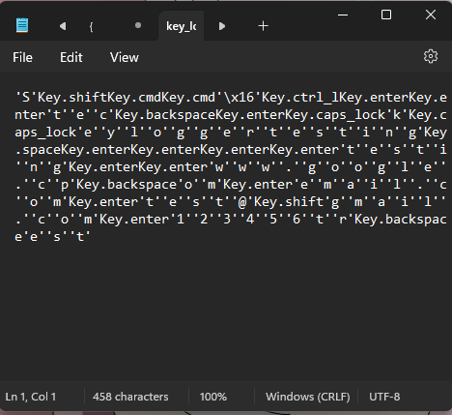
Result
Attached are the screenshots showcasing the execution of the keylogger system:
(Keylogger before starting)
(Keylogger after starting)
(Log File)

Slide 11
Conclusion
In conclusion, the development and implementation of the keylogger system present a significant advancement in enhancing cybersecurity measures and monitoring user activity. Through continuous monitoring and logging of keystrokes, the system provides valuable insights into user behavior, aiding in threat detection and forensic analysis. The intuitive user interface facilitates seamless interaction and configuration, empowering users with control over logging operations. With robust anomaly detection capabilities and comprehensive record-keeping, the keylogger system offers a proactive approach to cybersecurity, mitigating risks associated with unauthorized access and malicious activities. Overall, the keylogger system serves as a valuable tool for bolstering security measures and safeguarding sensitive information in both personal and organizational settings.

Slide 12
Future scope
Looking ahead, the keylogger system holds promise for further enhancements and expansions to address evolving cybersecurity challenges. Future iterations could incorporate advanced machine learning algorithms to improve anomaly detection and recognize complex patterns indicative of suspicious behavior. Additionally, integration with cloud-based platforms could enable centralized logging and analysis, facilitating real-time threat intelligence and proactive incident response. Moreover, enhancing compatibility with emerging technologies such as Internet of Things (IoT) devices and mobile platforms would extend the system's reach and effectiveness in diverse environments. Collaborative efforts with cybersecurity experts and industry stakeholders can foster innovation and refinement, ensuring the keylogger system remains at the forefront of cybersecurity defense strategies. Ultimately, continued research and development efforts will propel the keylogger system towards greater resilience and adaptability in safeguarding against evolving cyber threats.

Slide 13
References
GeeksforGeeks. (n.d.). Design a Keylogger in Python. Retrieved from https://www.geeksforgeeks.org/design-a-keylogger-in-python
ThePythonCode. (n.d.). Write a Keylogger in Python. Retrieved from https://thepythoncode.com/article/write-a-keylogger-python
Python Documentation. (n.d.). Retrieved from https://www.python.org/doc/
Tkinter Documentation. (n.d.). Retrieved from https://docs.python.org/3/library/tkinter.html
Pynput Documentation. (n.d.). Retrieved from https://pynput.readthedocs.io/en/latest/
JSON Documentation. (n.d.). Retrieved from https://docs.python.org/3/library/json.html
Various online tutorials and forums for Python programming and cybersecurity practices.

Slide 14
THANK YOU

